Slide 1

From Kick-off to Glory: Visualizing the Evolution of FIFA World Cups
Final Presentation
Team:
Bhargavi Dwivedi
Utkarsh Pratap Singh Jadon

Slide 2

F
Motivation and Objective
Motivation
FIFA World Cups have evolved drastically over the decades since its inception in 1930. We seek to uncover insights into the tournament’s growth, historical development of national teams’ performances, and how the globally increasing participation has affected the evolution FIFA World Cup
Objective
Do goals win you FIFA World Cups?

Slide 3
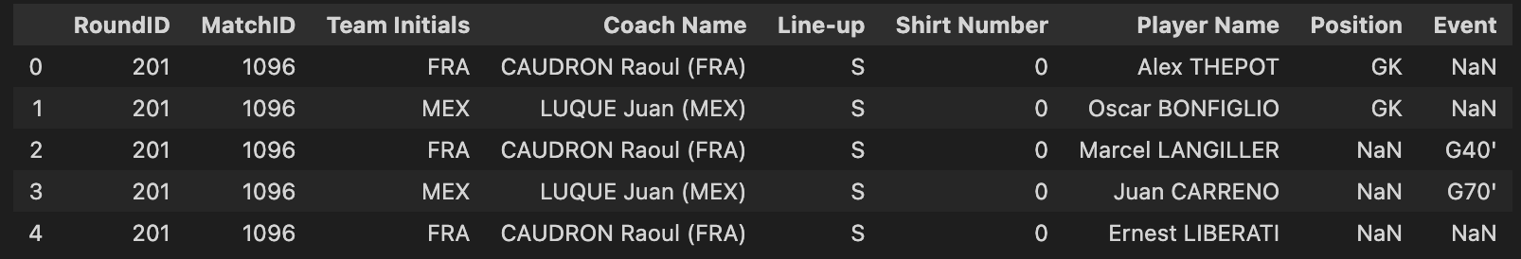
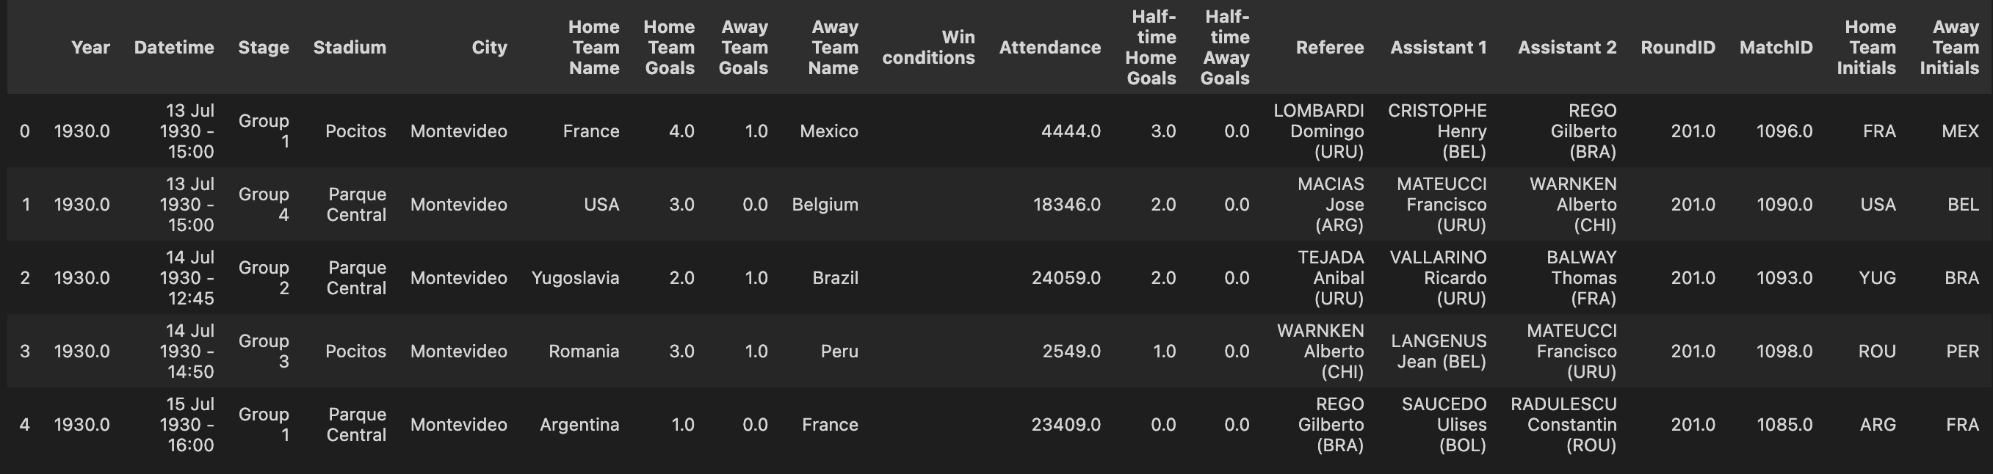
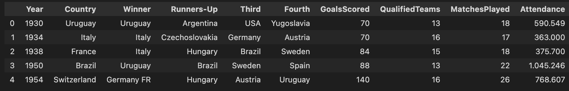
F
Data Collection and Analysis
WorldCupPlayers.csv
WorldCupMatches.csv
WorldCups.csv

Slide 4

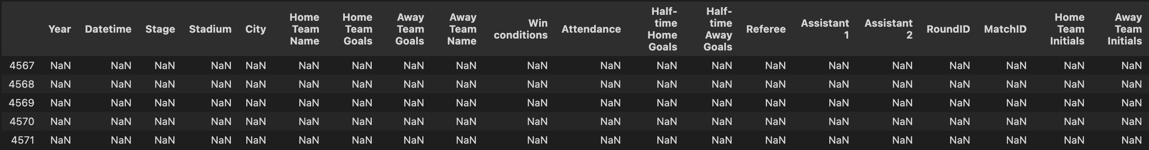
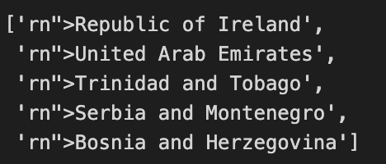
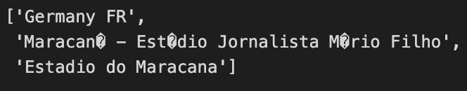
Data Cleaning
Issue 1: NaN values
Issue 2: Junk text
Issue 3: Old names

Slide 5
Demo

Slide 6
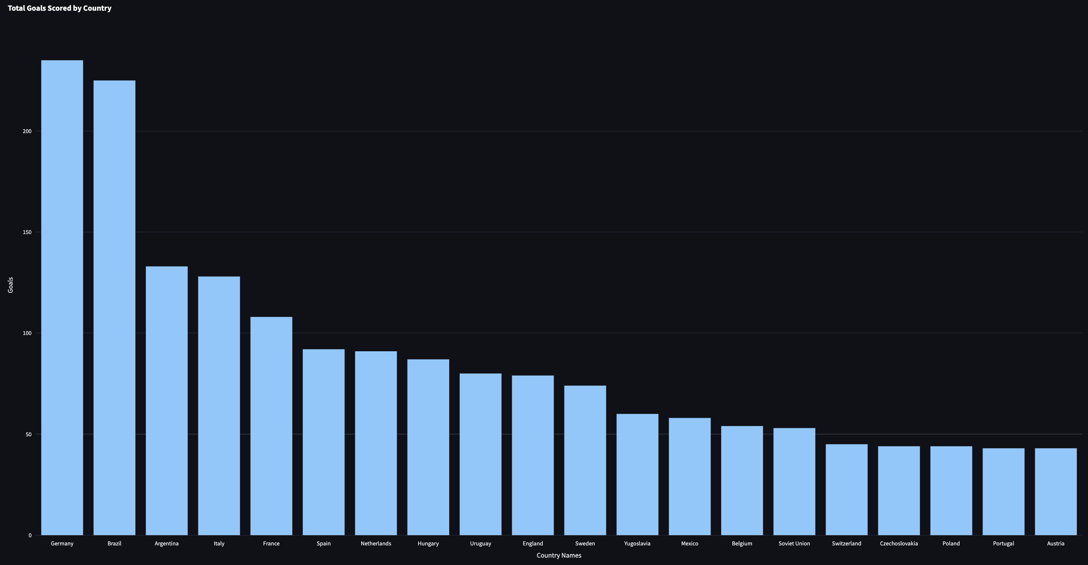
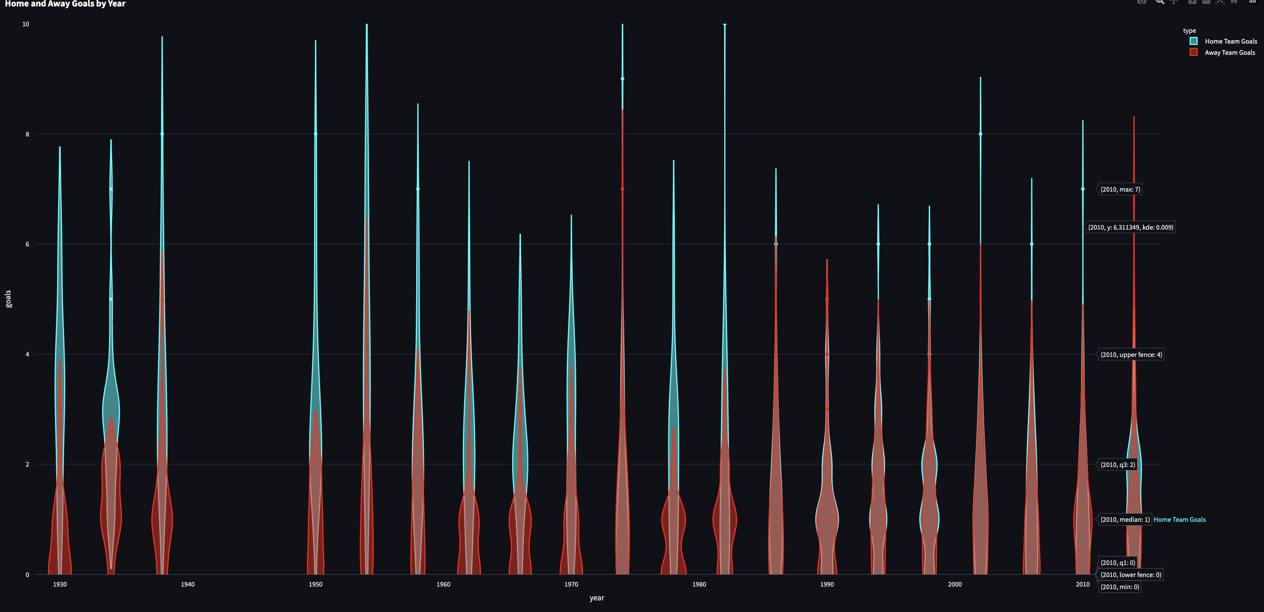
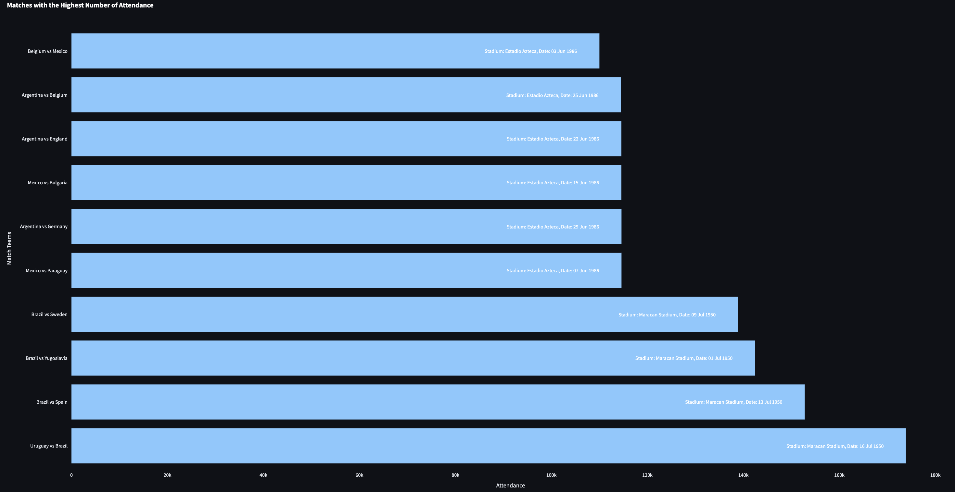
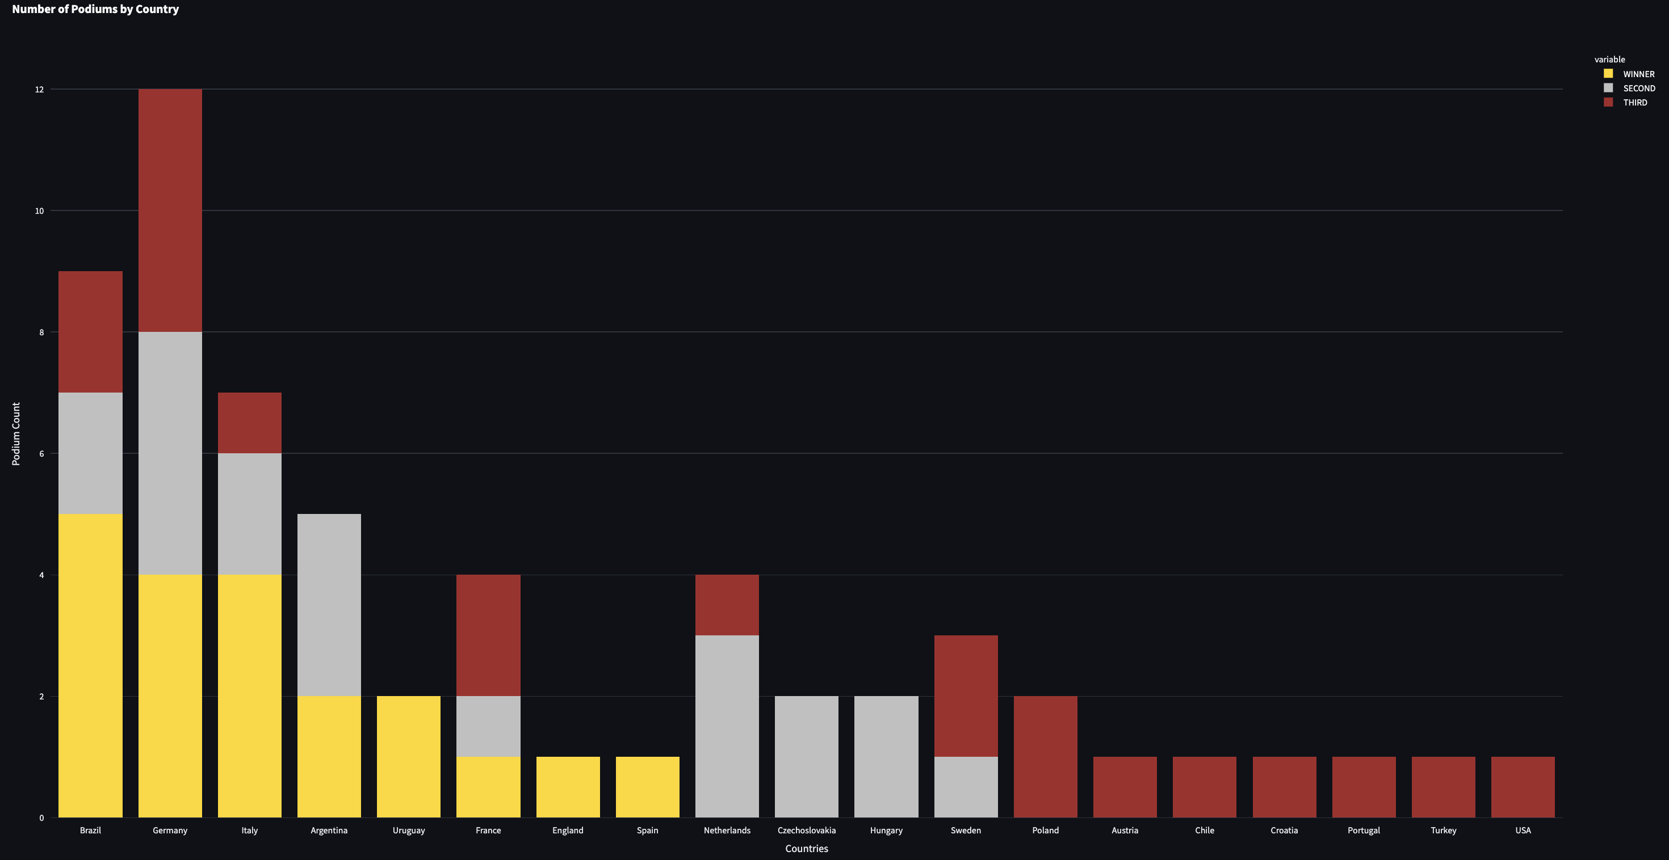
Results and Conclusion
Fig 1
Fig 2
Fig 3
Fig 4

Slide 7
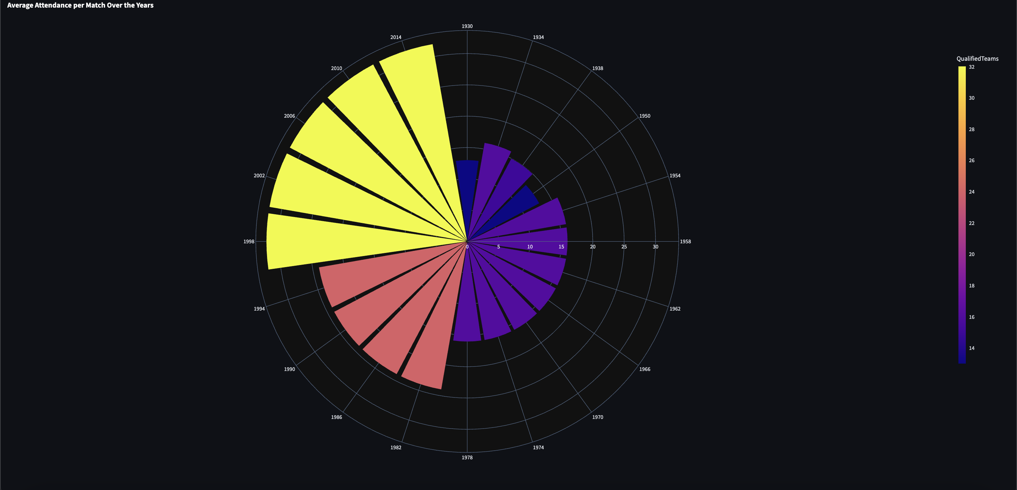
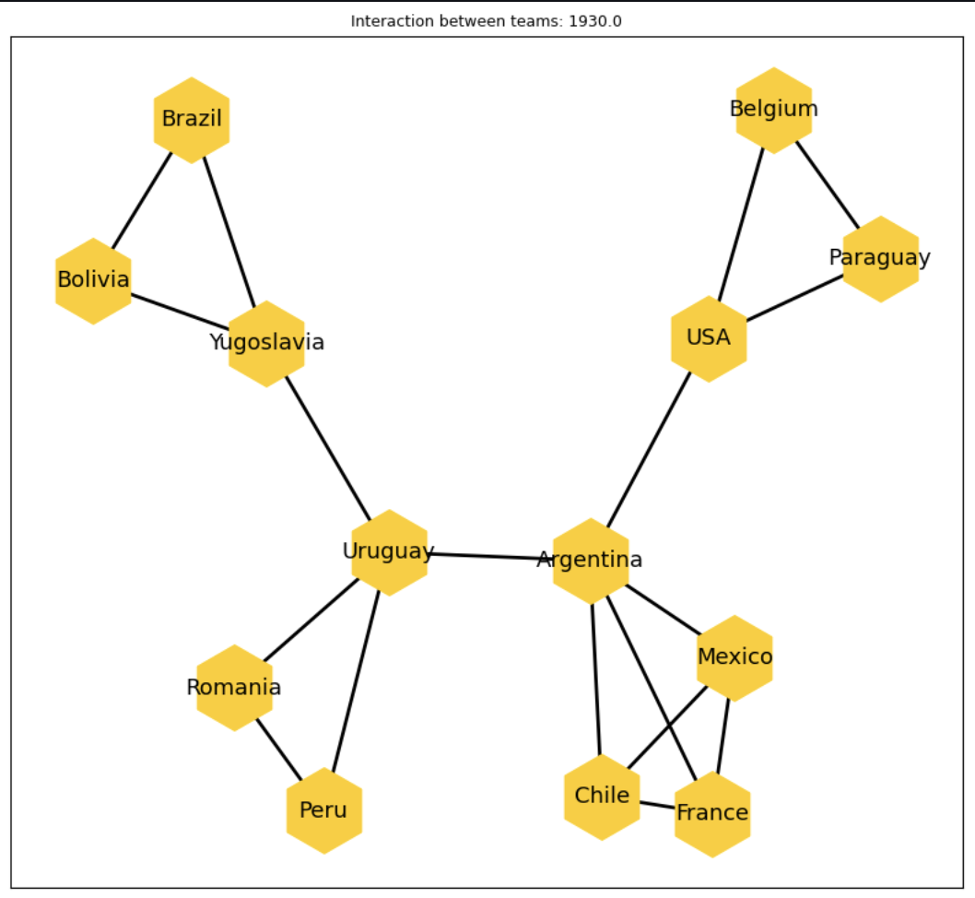
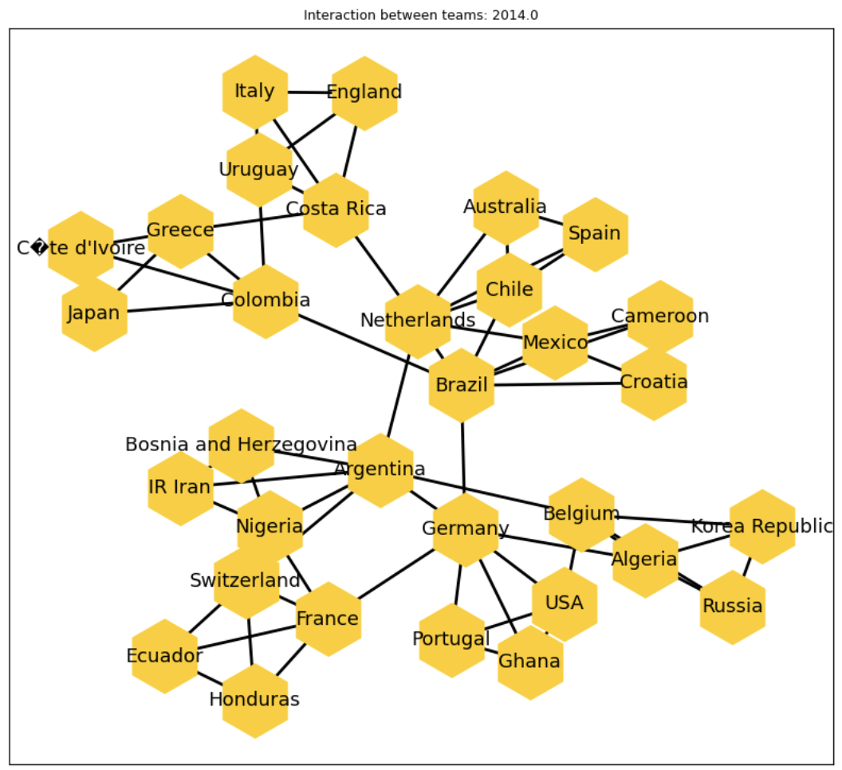
Exploratory Data Analysis
Fig 5
Fig 6
Fig 7

Slide 8
Conclusion
Comprehensive data analysis and visualization completed
Developed an interactive dashboard to explore World Cup trends
Team with the highest number of goals does not have the most World Cup titles
Scoring the most goals is not the sole determinant of World Cup success
Fan support plays a crucial role in team performance
Psychological benefits of home support contribute significantly to team success

Slide 9

Questions?

